Slide 1
Prospects for Peace in the Middle East: Glass Half…
Saeed A. Khan
Wayne State University

Slide 2

Syria

Slide 3
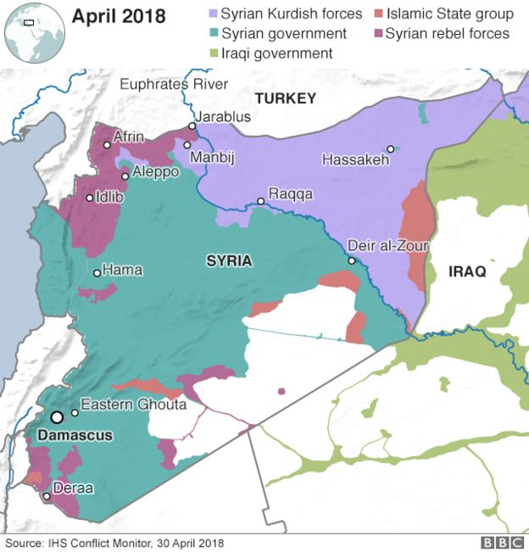
Syria 2018

Slide 4
Syria
ISIS
Assad
Russia
Iran
Israel

Slide 5

Israel

Slide 6
Israel
Golan Heights (Syria)
US Embassy
Palestine: “Deal of the Century”
Gulf States
Iran
Elections

Slide 7
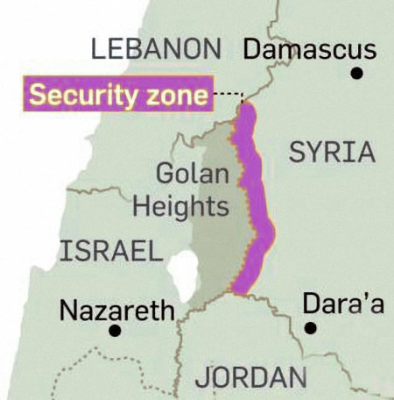

Oil in the Golan Heights

Slide 8
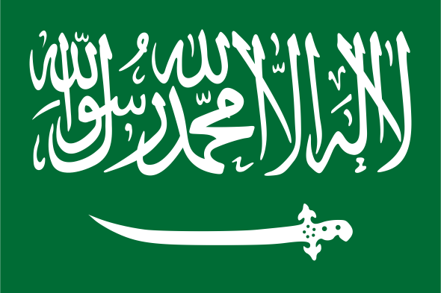
Saudi Arabia

Slide 9
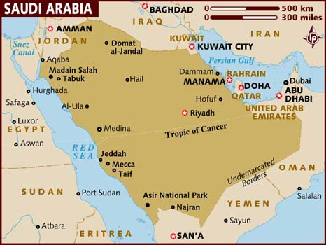

Slide 10
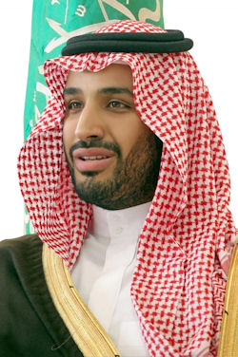
Muhammad bin Salman
b. 1985
Crown Prince
1st Deputy Prime Minister
Minister of Defence
Chief of the House of Saud Royal Court
Chairman, Council of Economic & Development Affairs

Slide 11
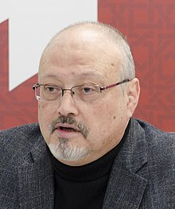
Jamal Khashoggi (1958-2018)

Slide 12
Saudi Regional Engagements
Israel
  Don’t Ask/Don’t Tell
Iran
  Nuclear Deal
  Proxy Wars
Syria
  Anti-Assad Campaign
Qatar
  Blockade since 2017 by Saudi Arabia and UAE
  Proxy Proxy War
Yemen
  Saudi “Vietnam”

Slide 13
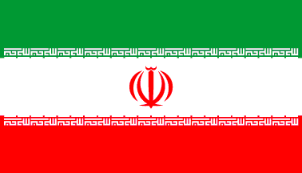
Iran

Slide 14
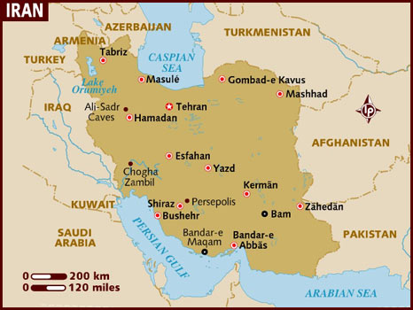

Slide 15
US-Iran Nuclear Deal = More Arms Sales
Saudi Arabia: $80 Billion
UAE: $23 Billion
Qatar: $11 Billion
  2011: Boeing opens office in Doha
  2015: Lockheed-Martin opens office in Doha
    CEO Marylinn Hewson contends that L-M needs to boost global arms sales from 25-30% total revenue to offset reduction in Pentagon orders post-9/11
Israel: Additional $1.9 Billion (beyond annual $3-4 Billion) to mollify Iran deal anxieties
Source: “Sale of U.S. Arms Fuels the Wars of Arab States,” New York Times, April 18, 2015

Slide 16
US Policy Re: Iran
Restoration of Sanctions
Reduce Influence in Syria & Lebanon
Antagonize & Destabilize Leadership
Potential (Pre-Emptive) Military Strike

Slide 17
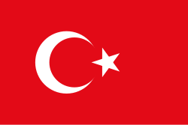
Turkey

Slide 18
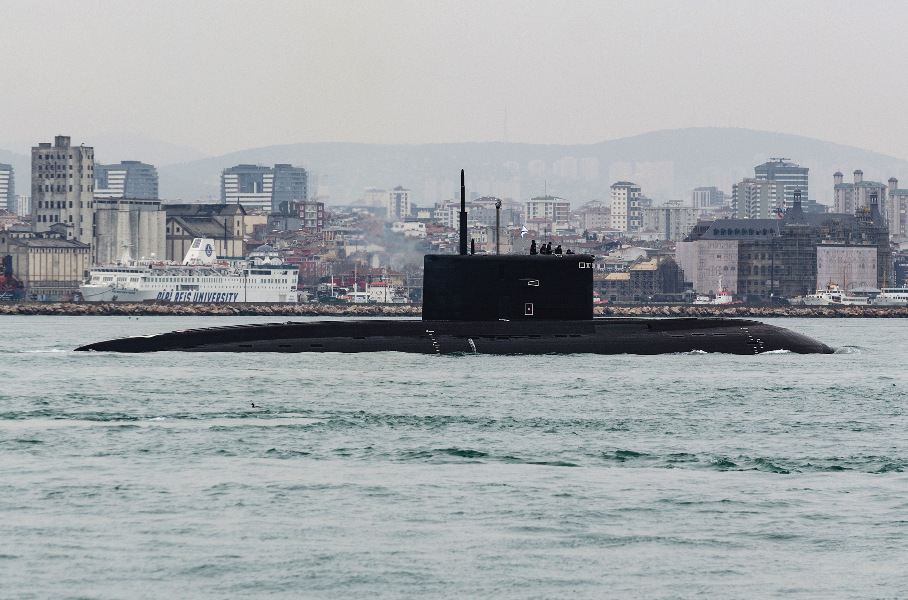
Krasnodar (B-265) in the Bosphorus: March 19, 2019

Slide 19
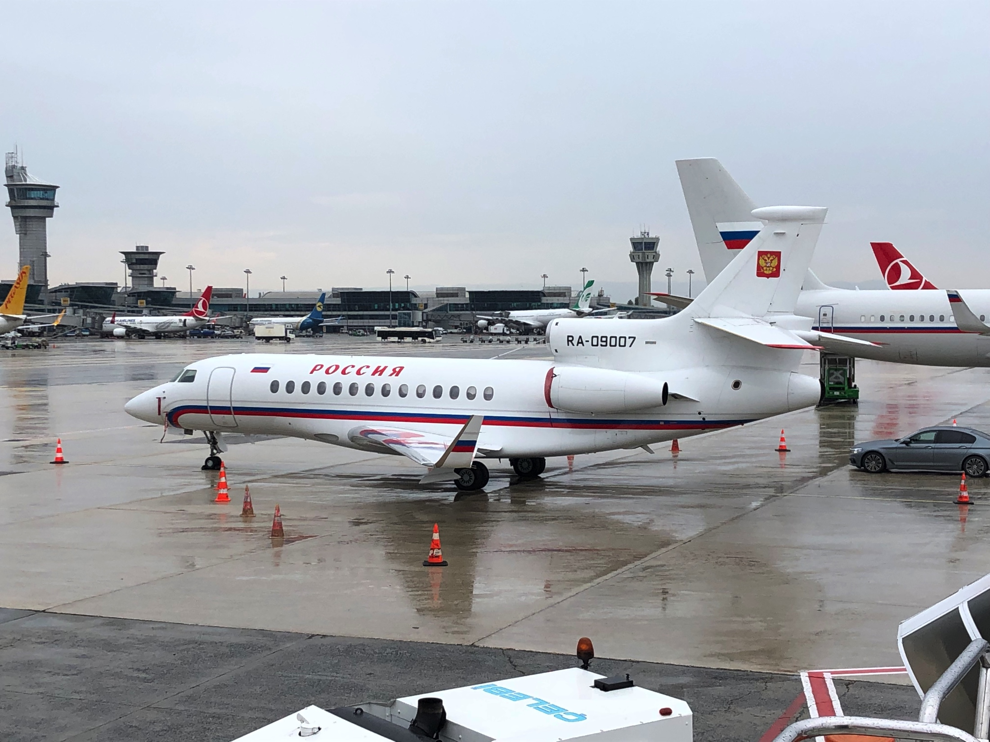
Putin in Istanbul: Nov. 19, 2018

Slide 20
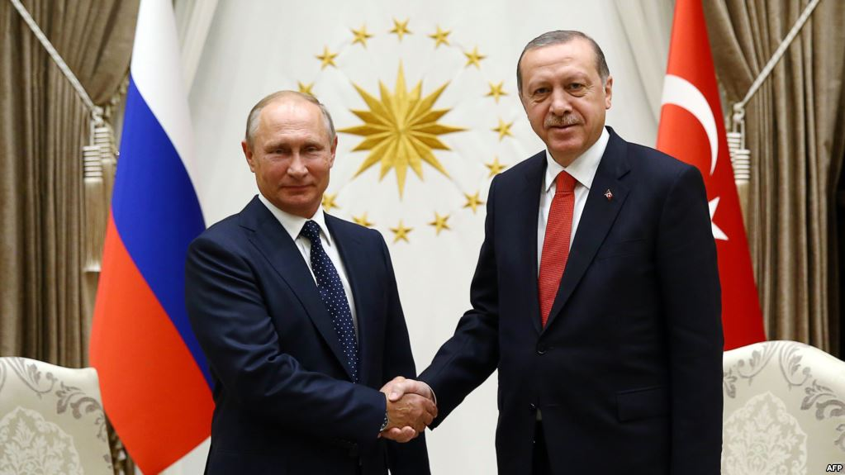
Vladimir Putin & Recep
Tayyip Erdogan

Slide 21
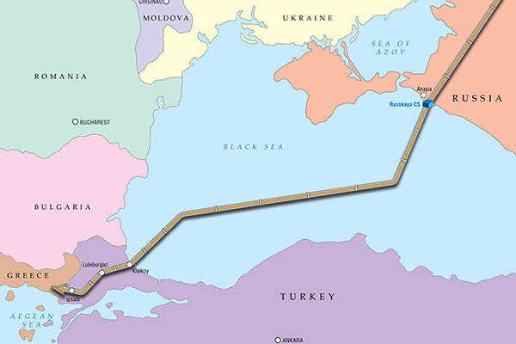
Turko-Russian Natural Gas Pipeline: Turkstream

Slide 22
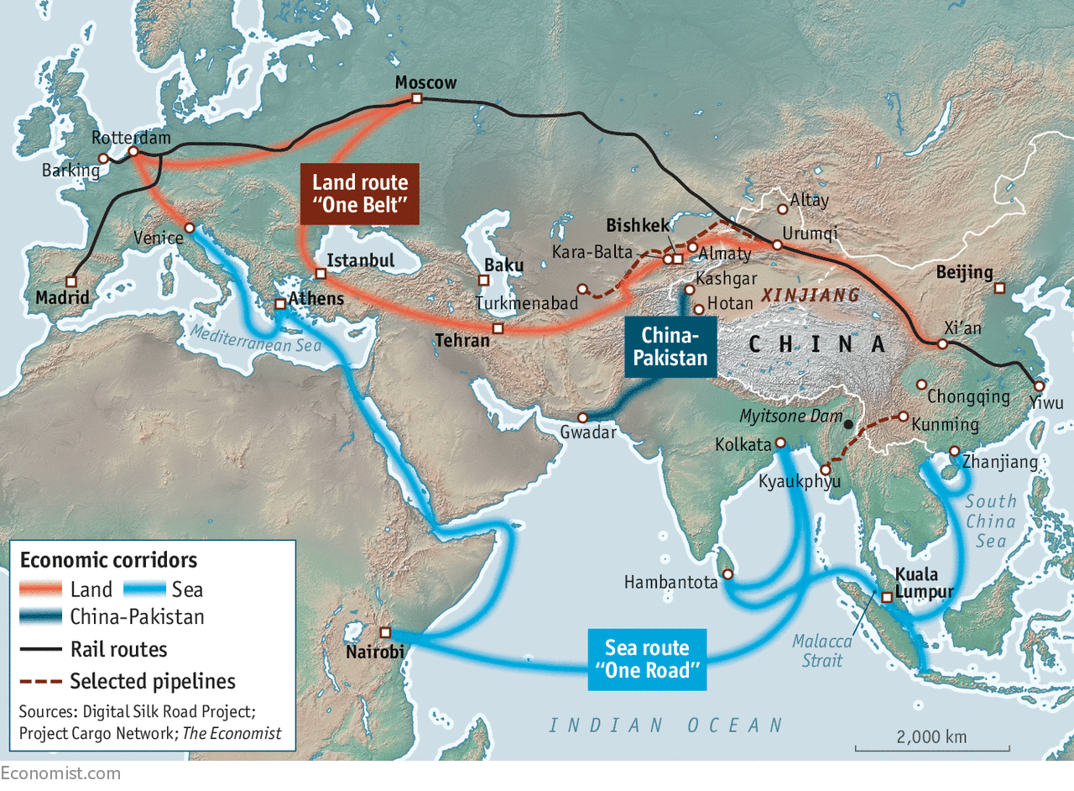
The New Silk Road: China’s Belt & Road Initiative

Slide 23
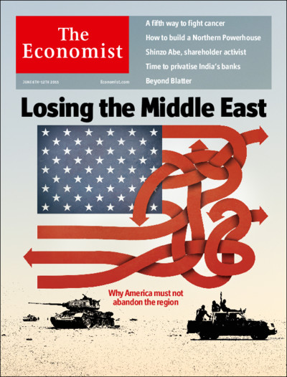
The Economist
June 6, 2015

